Slide 1

Spotify Analysis Dataset 2025
12/01/2025
Team: Robert & Shadmun
Members: Shadmun (ID 1620656) and Robert (ID 1578752)
Professor: Dr. Hardik Gohel, Ph.D.
Class: COSC 6315

Slide 2
Problem Statement
Many Spotify users stop using the platform (“churn”), impacting revenue and growth
Business need: identify which users are likely to churn before they leave
Research need: understand behavioral patterns that distinguish churners from loyal users
Goal: build models that can predict churn and discover meaningful user segments
Robert & Shadmun
12/01/2025

Slide 3
Project Objectives
Use supervised learning to predict the binary churn label is_churned
Use unsupervised learning (k-Means) to segment users into behavioral clusters
Explore which features are most associated with churn
age, listening time, skips, ads, etc.
Evaluate model performance and discuss limitations, especially class imbalance
Propose future improvements for more reliable churn prediction
Robert & Shadmun
12/01/2025

Slide 4
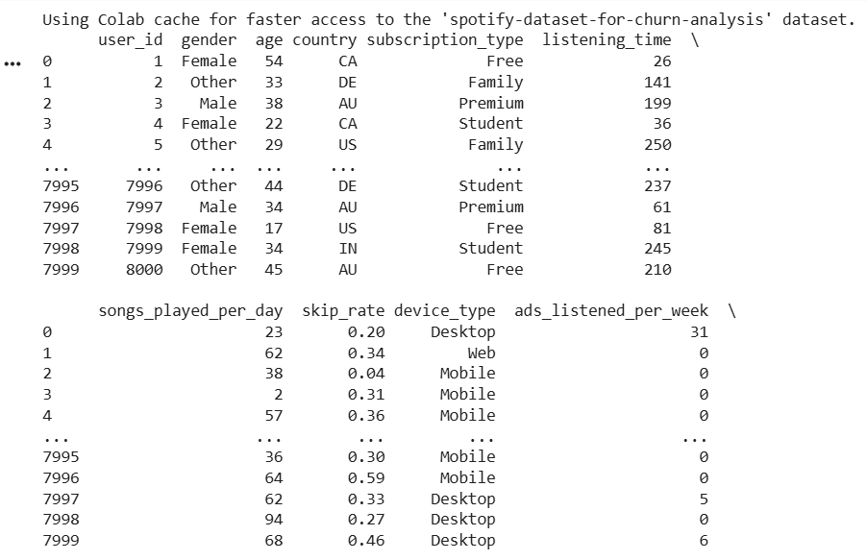
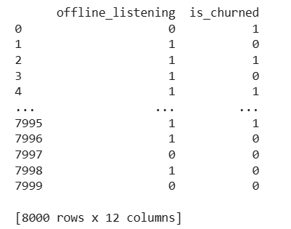
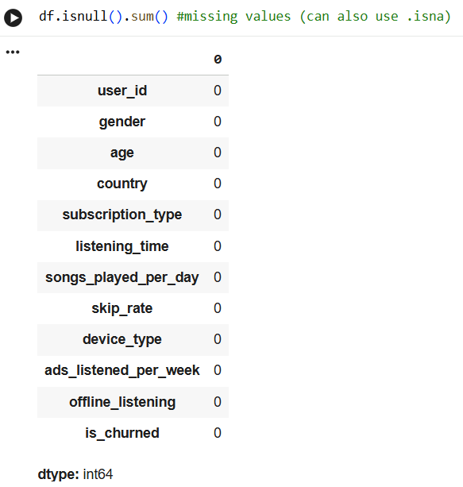
Dataset Overview
Source: Kaggle – Spotify Dataset for Churn Analysis
nabihazahid/spotify-dataset-for-churn-analysis
Size: 8,000 user records (rows)
No missing values after loading and type conversion
Each row represents a unique Spotify user with demographics + listening behavior
Target variable: is_churned (boolean – churned vs non-churned)
Robert & Shadmun
12/01/2025

Slide 5
Dataset Overview (continued)
Numerical features:
Age
Listening time
Songs played per day
Skip rate
Ads listened to per week
Categorical / boolean features:
Gender
Country
Subscription type
Device type
Offline listening (True/False)
Target: is_churned (True = churned, False = active)
Robert & Shadmun
12/01/2025

Slide 6
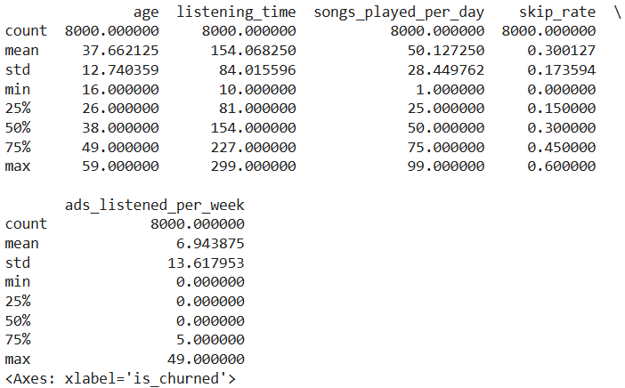
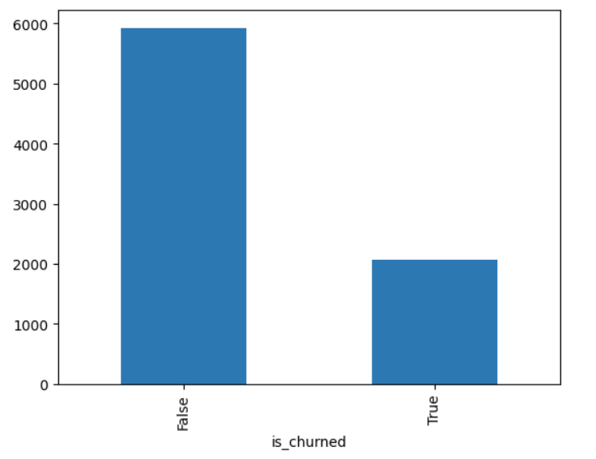
EDA Highlights: Dataset & Churn Distribution
Dataset is balanced across many demographics and device types
Strong class imbalance in target:
~74.11% users have not churned
~25.89% users have churned
Imbalance implies models may over-predict the majority class (non-churners)
Free-tier users are uniquely exposed to ads, so ad-related analysis focuses on them
Robert & Shadmun
12/01/2025

Slide 7
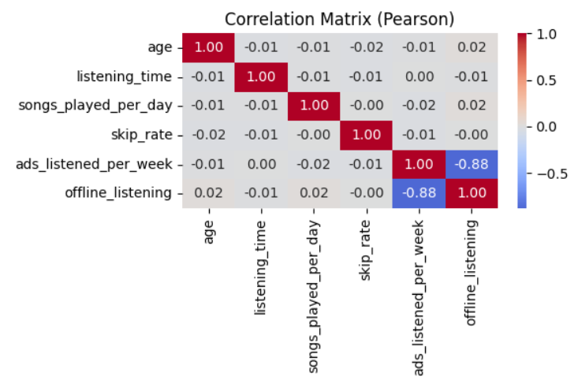
EDA Highlights: Behavior & Correlations
Age: ranges 16–59; mean ~38, relatively symmetric distribution
Listening time & songs per day: broad spread; some users show very high engagement
Skip rate: typically moderate; a subset of users frequently skip tracks
Ads listened per week: heavily concentrated near 0 with a long tail of high-ad users
Pearson correlations show:
No single feature has a strong linear correlation with is_churned
Churn appears to be driven by multi-factor interactions, not one variable
Note: Offline listening a premium feature with no ads, while users who are always online (especially free-tier users) are the ones getting ads.
Robert & Shadmun
12/01/2025

Slide 8
Data Preprocessing
Converted data types: user_id to string, categorical variables to category, churn/flags to boolean
One-hot encoded categorical features like gender, country, device, subscription_type, etc.
Standardized numerical features like age, listening_time, songs_played_per_day, skip_rate, and ads_listened_per_week
Constructed df_model containing all model-ready features + target
For clustering, selected and scaled a subset: skip_rate, songs_played_per_day, age, listening_time
Robert & Shadmun
12/01/2025

Slide 9
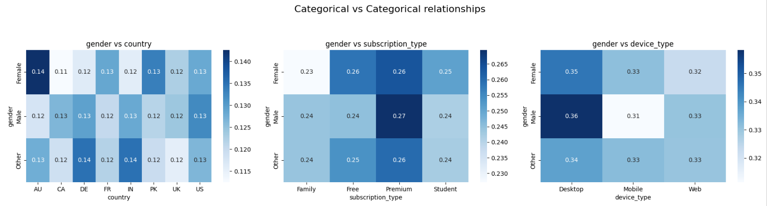
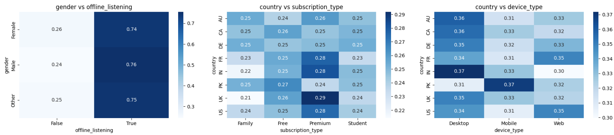
Relationships between categories
Robert & Shadmun
12/01/2025

Slide 10
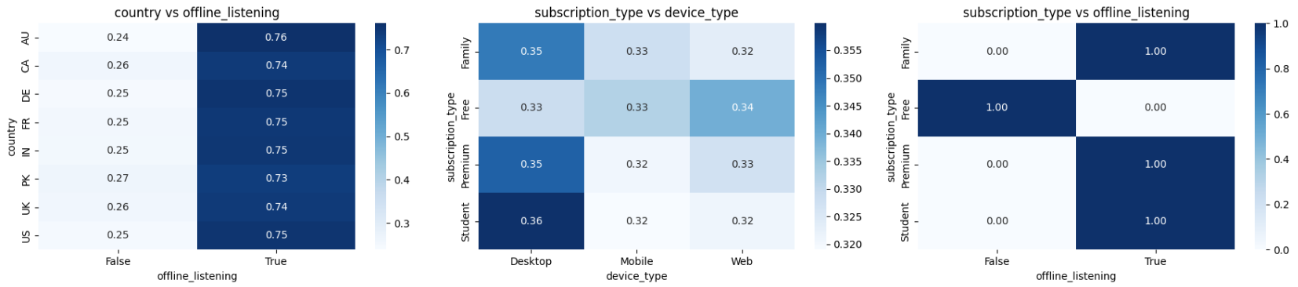
Relationships between categories
Robert & Shadmun
12/01/2025

Slide 11
Modelling Strategies
Supervised Learning (Classification):
Predict is_churned for each user
Models:
Logistic Regression
Decision Tree
k-Nearest Neighbors (KNN)
Random Forest
Unsupervised Learning (Clustering):
k-Means clustering on key behavioral features
Aim is to discover user segments based on listening patterns and skip behavior
Robert & Shadmun
12/01/2025

Slide 12
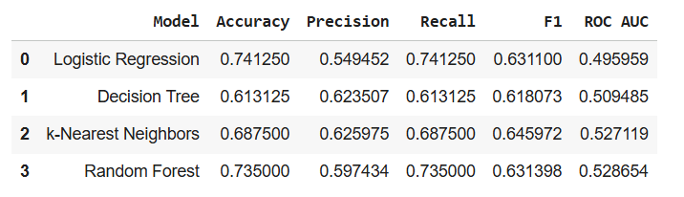
Algorithm Deep Dive: Logistic Regression
Type: Linear classifier for binary outcomes
Input: All preprocessed numerical + one-hot encoded features
Train/Test split: 80/20 with stratification on is_churned
Performance (overall): Accuracy ≈ 0.741, Precision ≈ 0.549, Recall ≈ 0.741, F1 ≈ 0.631, ROC AUC ≈ 0.496
Key issue: Confusion matrix shows the model heavily favors the non-churn class. Also, very poor recall for true churners despite decent aggregate metrics
Robert & Shadmun
12/01/2025

Slide 13
Algorithm Deep Dive: Random Forest
Type: Ensemble of decision trees using bagging
Motivation: Capture non-linear relationships and interactions between features
Performance (overall): Accuracy ≈ 0.735, Precision ≈ 0.597, Recall ≈ 0.735, F1 ≈ 0.631, ROC AUC ≈ 0.529
Class imbalance effect: Identified only 3 true churners out of 414, with recall ≈ 0.01 for the churn class
Feature importance (top drivers): listening_time, songs_played_per_day, skip_rate, age. Indicates engagement and skipping behavior are influential in model decisions
Robert & Shadmun
12/01/2025

Slide 14
Evaluation Metrics & Overall Comparison
Single 80/20 stratified split used for baseline model evaluation
Metrics used: Accuracy, Precision, Recall, F1-score, ROC AUC
Overall performance (test set):
~Accuracy ranged from 0.613 (Decision Tree) to 0.741 (Logistic Regression)
F1 scores around 0.62–0.65 across models
ROC AUC values between 0.496 and 0.529, only slightly better than random
Observation: On average, models correctly classify many users, but do not strongly separate churners from non-churners
Robert & Shadmun
12/01/2025

Slide 15
Evaluation Metrics: Imbalance and Business Implication
Despite reasonable overall accuracy, minority class performance is poor
Examples:
Random Forest: only 3 true churners detected, churn recall ≈ 0.01
Decision Tree and KNN improve churn recall somewhat but still miss most churners
Decision Tree and KNN improve churn recall somewhat but still miss most churners
Severe class imbalance leads models to favor predicting non-churn
Business implication: Missing churners or false negatives are costly. Identifying them is more important than overall accuracy
Robert & Shadmun
12/01/2025

Slide 16
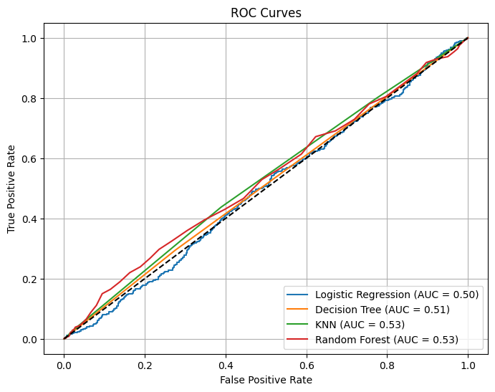
Results and Discussion
The logistic regression model has the best accuracy score, and logistic regression does best when it comes to recall. The k-nearest neighbors model has the highest precision and F1 score. For ROC AUC, the best performing model is random forest.
Robert & Shadmun
12/01/2025

Slide 17
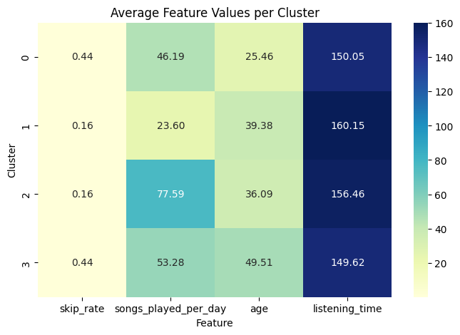
k-Means Clustering Results
Cluster 0 – Young (~25 years), High Skip-Rate Listeners. Likely exploratory or easily dissatisfied listeners
Cluster 1 – Older (~39), Low Engagement, Low Skip-Rate. Suggests passive “background listening” behavior
Cluster 2 – Average Age, High Engagement, Low Skip-Rate. Represents highly engaged, satisfied listeners
Cluster 3 – Oldest(~49), High Skip-Rate, Moderate Engagement. Potential frustration or mismatched recommendations
Robert & Shadmun
12/01/2025

Slide 18
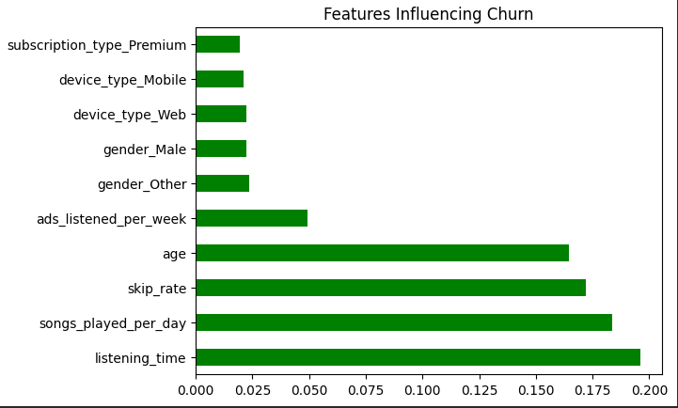
Conclusion & Future Work
Random forest is the best performing model
The most important features from the dataset are listening time, songs played per day, skip rate, and age
Traditional classifiers like Logistic, Tree, KNN, Random Forest struggle to identify churners
Clustering helps uncover user personas that can be targeted with tailored strategies
Future Work:
Tune future models to focus on important features listed above.
Use more advanced models (gradient boosting and deep learning)
Robert & Shadmun
12/01/2025

